Slide 1
JIRA – A PROJECT MANAGEMENT TOOL
Presented by:
Noor & Aditi

Slide 2

AGENDA
Introduction to Jira
Steps to create a project
Steps to create an issue
Dashboard
Reports

Slide 3

INTRODUCTION
A bug-tracking system and project management software that was developed and launched in 2002 by Atlassian.
An agile project management tool that supports any agile methodology, be it scrum, Kanban, or your own unique flavor. From agile boards, backlogs, roadmaps, reports, to integrations and add-ons you can plan, track, and manage all your agile software development projects from a single tool.
One of the main benefits of JIRA for project management is that teams can easily work in it with different methodologies be it Scrum, Kanban or traditional Waterfall with capabilities to estimate time and plan sprints.

Slide 4

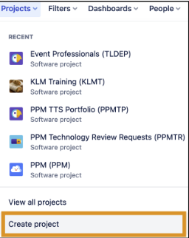
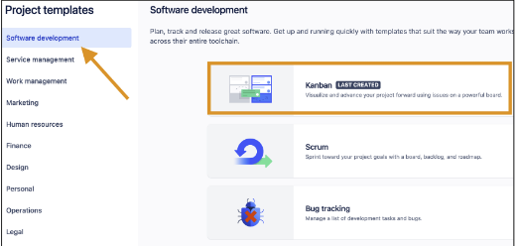

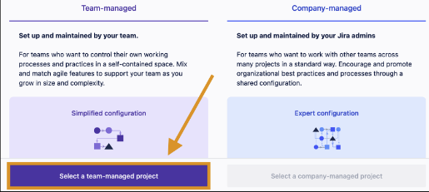
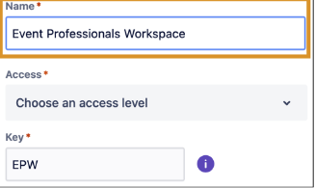
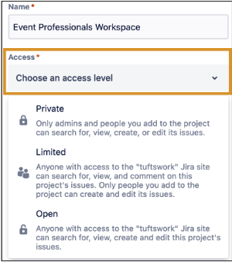
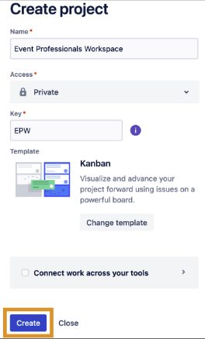
STEPS TO CREATE A PROJECT
1
2
3
1. At the top of the Jira page, click Projects.
2. A dropdown menu appears, listing all projects you have access to. At the bottom, click Create Project.
3. Under Project Templates, be sure Software Development is selected, then click Kanban.
4. In the top right of the info panel, click Use Template
5. At the bottom of the Team-managed column, click Select a team-managed project
6. Give your project a meaningful Name. (Note: The Key will be automatically generated using the name’s initials.)
7. Choose the Access Level of your project. This will apply to all parts of your project, including all issues.
4
5
6
7
8

Slide 5
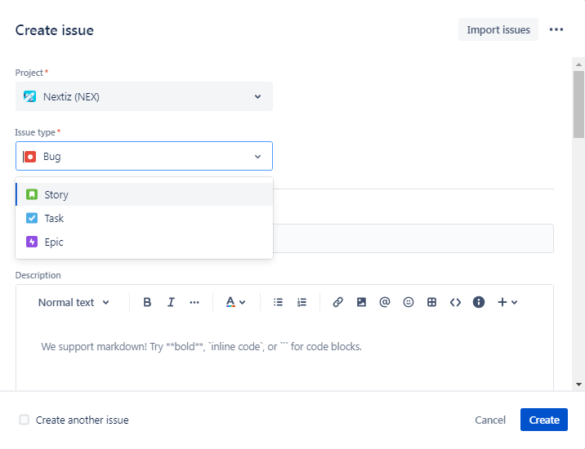
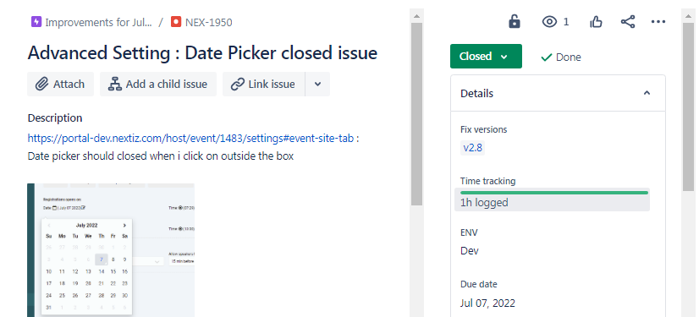
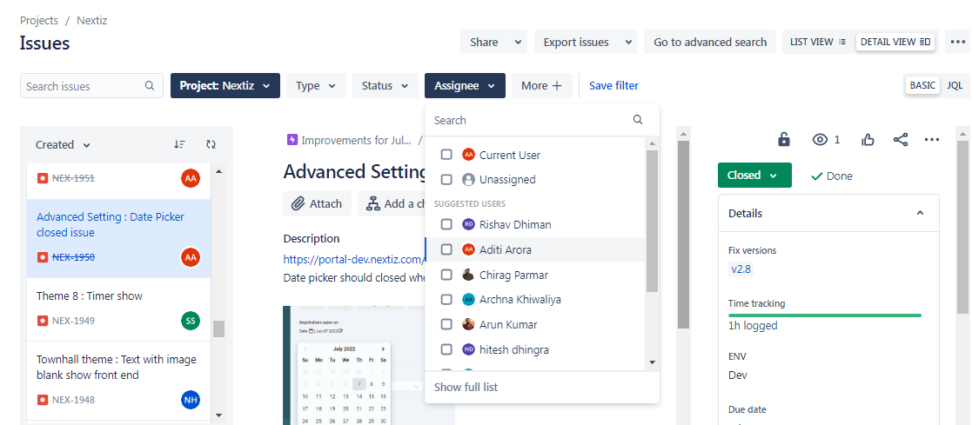
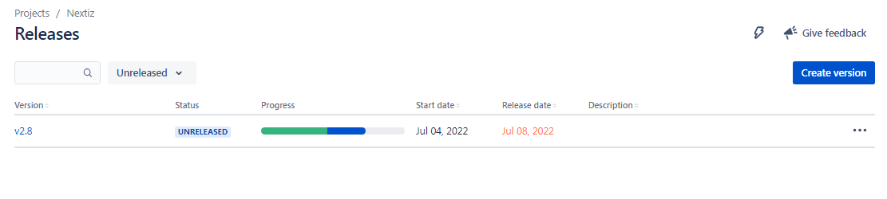
STEPS TO CREATE AN ISSUE

Slide 6
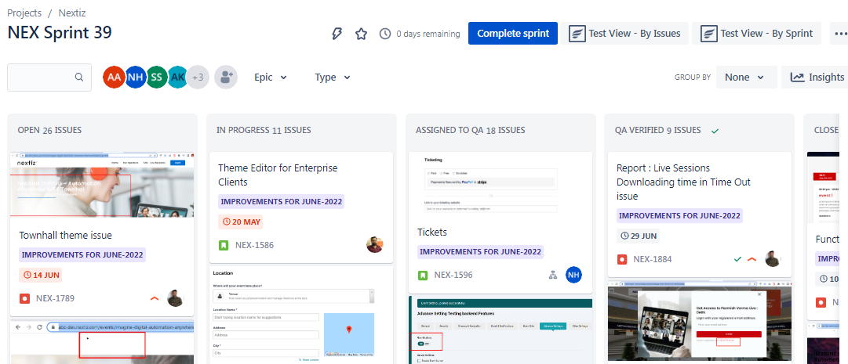
DASHBOARD

Slide 7
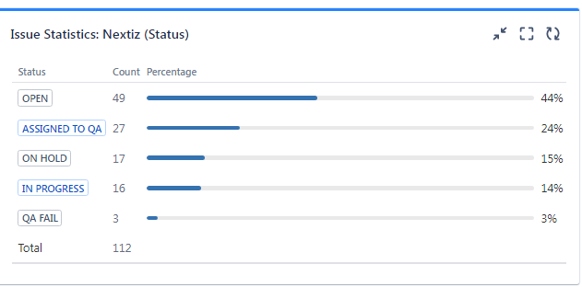
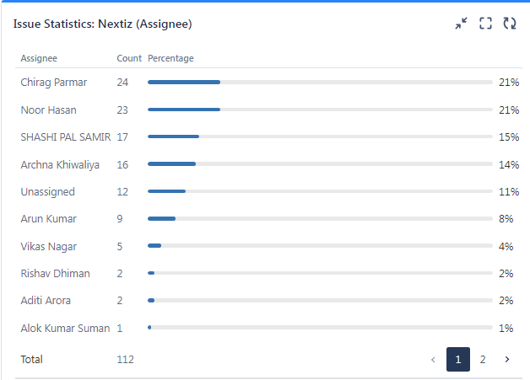
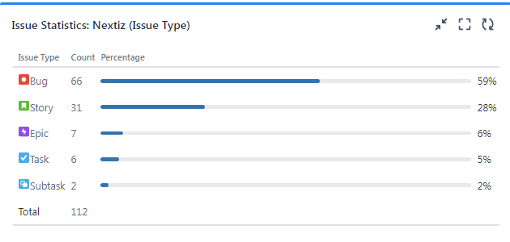
REPORTS

Slide 8
Thanks!

