Slide 1


HTML5 & CSS3 Features

Slide 2
Agenda
About HTML5
Introduction of New Elements
Semantic Structure
Web Storage API
CSS3 New Features

Slide 3
About HTML5
HTML 5 is a revision of the Hypertext Markup Language (HTML), the standard programming language for creating webpages and other information that can be displayed on web browser and to solve browser compatibility problems.
Cleaner Markup / Improved Code
Support Rich Media Elements
Enhanced Forms
Interactivity

Slide 4

Introduction of New Elements
- Structural Tags - Semantic Tags - Embedded Content Tags - Formatting Tags - Form Tags

Slide 5
Structural Tags
These are the basic tags which must be a part of every web page. They tell the browser that the document is a web page. <!DOCTYPE HTML> <html> <head> <title>Title of Webpage</title> </head> <body> This is where the main part of the web page would go </body> </html>

Slide 6
Semantic Tags
A semantic element clearly describes its meaning to both the browser and the developer. <header></header> <footer></footer> <section></section> <article></article> <nav></nav> <main></main> <time></time>

Slide 7
Embedded Content Tags
These tags defines a container for external resource such as webpage, picture, video, audio etc. <embed></embed> <audio></audio> <video></video> <source /> <canvas></canvas> <figure></figure> <figcaption></figcaption>

Slide 8
Formatting Tags
HTML Formatting is a process of formatting text for better look and feel. Some new formatting tags are <mark></mark> <progress value="80" max="100" ></ progress>

Slide 9
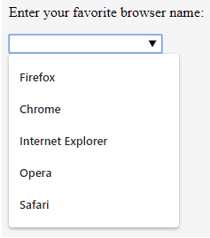
Form Tags
<datalist> tag comes with pre-defined option and provide autocomplete features for input fields <input type=“text” list="browsers"> <datalist id=“browsers”> <option value=“Firefox"> <option value=“Chrome"> <option value=“Internet Explorer"> <option value=“Opera"> <option value=“Safari"> </datalist>

Slide 10
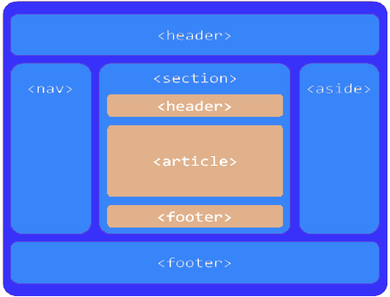
Semantic Structure
HTML semantic structure element clearly describes its meaning to both the browser and the developer rather than just a presentation.
It makes web pages more informative, adaptable, Accessible
Allowing browsers and search engines to crawl and interpret content better.

Slide 11
Web Storage API
In HTML5 webpages can store data locally within the user’s browser.
Earlier this was done using cookies.
Web Storage is more secure and faster.
Store large amount of data without affecting the web performance.

Slide 12
Local Storage
Stores data with no expiration date.
Data will remain stored when the browser closed.
5MB per app per browser.
Data is stored in key value pairs
Methods: localStorage.setItem(key, value) localStorage.getItem(key) localStorage.removeItem(key) localStorage.clear()

Slide 13
Session Storage
Stores data for one session on temporary basis.
Data will be deleted once the browser closed.
5MB per app per browser.
Data is stored in key value pairs
Methods: sessionStorage.setItem(key, value) sessionStorage.getItem(key) sessionStorage.removeItem(key) sessionStorage.clear()

Slide 14
CSS3 New Features
With CSS3, web browsers natively produce a lot of the styling effects that were once only achievable through creative HTML hacks and images editing or animation programs like Photoshop, Flash etc.
Text Shadow and Box Shadow
Gradients
Multiple Backgrounds
Animations
Web Fonts

Slide 15

Text Shadow
The text-shadow property adds shadow to text.
Syntax: text-shadow: h-shadow v-shadow blur-radius color; text-shadow: 4px 4px 4px #ff0000; e.g.

Slide 16
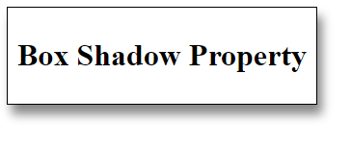
Box Shadow
The box-shadow property adds shadow to any element.
Syntax: box-shadow: h-offset v-offset blur spread color; box-shadow: 4px 4px 4px #000000; e.g.

Slide 17
Gradients
CSS gradients let you display smooth transitions between two or more specified colors. There are 3 types of gradients in CSS3:
Linear Gradients
Radial Gradients
Conic Gradients

Slide 18

Linear Gradient
Defined direction of this gradient goes down/up/left/right/diagonally Syntax: background-image: linear-gradient(direction, color-stop1, color-stop2, ...); background-image: linear-gradient(to right, red, yellow); e.g.

Slide 19

Radial Gradient
A radial gradient is defined by its center. Syntax: background-image: radial-gradient(shape size at position, start-color, ..., last-color); background-image: radial-gradient(circle, red, yellow, green); e.g.

Slide 20

Conic Gradient
A conic gradient is a gradient with color transitions rotated around a center point. Syntax: background-image: conic-gradient([from angle] [at position,] color [degree], color [degree], ...); background-image: conic-gradient(red 45deg, yellow 90deg, green 210deg); e.g.

Slide 21
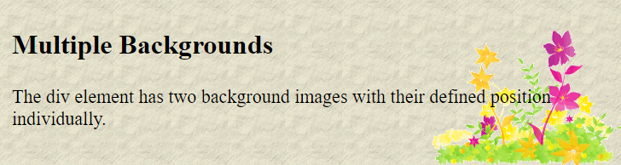
Multiple Background
CSS3 allow you to add multiple background images for an element. Through background-image property Syntax: background-image: url(img_flwr.gif), url(paper.gif); background-position: right bottom, left top; background-repeat: no-repeat, repeat; e.g.

Slide 22
Web Fonts
With CSS3 we can use web fonts that services like Google Fonts, Typekit which let you embed beautiful fonts in webpage by simple including stylesheet. We have icon fonts like FontAwesome which contain vector icons. This was all made possible by the CSS3 @font-face rule @font-face {
font-family: myFirstFont;
src: url(sansation_light.woff);
}

Slide 23
Animation
CSS animation reduce the use of JavaScript, jQuery or Flash!.
CSS animation allow element to change from one style to another.
To use CSS animation, specify @keyframes Rule for the animation
e.g.
@keyframes example {
from {background-color: red;}
to {background-color: yellow;}
}
div {
width: 100px; height: 100px;
background-color: red;
animation-name: example;
animation-duration: 4s;
animation-iteration-count: 2 / infinite;
animation-direction: normal / reverse / alternate / alternate-reverse
}

Slide 24
Thank you
Shashi Pal Samir
Shashipal.Samir@nvish.com

